Slide 1
ML

Slide 2
Comparing machine learning models in scikit-learn
How do I choose which model to use for my supervised learning task?
How do I choose the best tuning parameters for that model?
How do I estimate the likely performance of my model on out-of-sample data?

Slide 3
Review
Classification task: Predicting the species of an unknown iris
Used three classification models: KNN (K=1), KNN (K=5), logistic regression
Need a way to choose between the models

Slide 4
Evaluation procedure #1: Train and test on the entire dataset
Train the model on the entire dataset.
Test the model on the same dataset, and evaluate how well we did by comparing the predicted response values with the true response values
# read in the iris data
from sklearn.datasets import load_iris
iris = load_iris()
# create X (features) and y (response)
X = iris.data
y = iris.target

Slide 5
Logistic regression
# import the class
from sklearn.linear_model import LogisticRegression
# instantiate the model (using the default parameters)
logreg = LogisticRegression()
# fit the model with data
logreg.fit(X, y)
# predict the response values for the observations in X
logreg.predict(X)
# store the predicted response values
y_pred = logreg.predict(X)
# check how many predictions were generated
len(y_pred)

Slide 6
Classification accuracy
Proportion of correct predictions
Common evaluation metric for classification problems
Known as training accuracy when you train and test the model on the same data
# compute classification accuracy for the logistic regression model
from sklearn import metrics
print(metrics.accuracy_score(y, y_pred))

Slide 7
KNN (K=5)
from sklearn.neighbors import KNeighborsClassifier
knn = KNeighborsClassifier(n_neighbors=5)
knn.fit(X, y)
y_pred = knn.predict(X)
print(metrics.accuracy_score(y, y_pred))
0.966666666667

Slide 8
KNN (K=1)
knn = KNeighborsClassifier(n_neighbors=1)
knn.fit(X, y)
y_pred = knn.predict(X)
print(metrics.accuracy_score(y, y_pred))
1.0

Slide 9
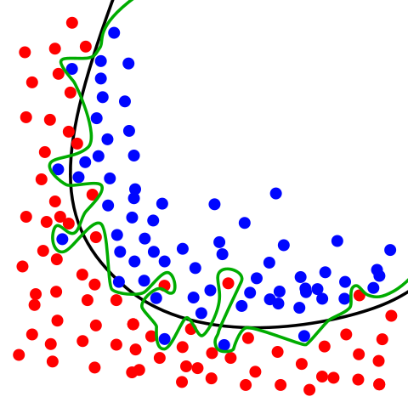
Problems with training and testing on the same data
Goal is to estimate likely performance of a model on out-of-sample data
But, maximizing training accuracy rewards overly complex models that won't necessarily generalize
Unnecessarily complex
models overfit the training data

Slide 10
Evaluation procedure #2:
Train/test split
Split the dataset into two pieces: a training set and a testing set.
Train the model on the training set.
Test the model on the testing set, and evaluate how well we did.
# STEP 1: split X and y into training and testing sets
from sklearn.cross_validation import train_test_split
X_train, X_test, y_train, y_test = train_test_split(X, y, test_size=0.4, random_state=4)

Slide 11
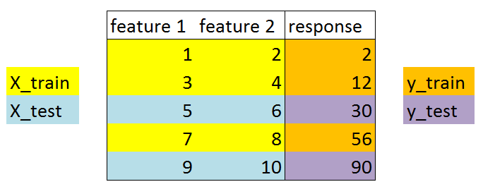
Train/Test split Data

Slide 12
Model can be trained and tested on different data
Response values are known for the testing set, and thus predictions can be evaluated
Testing accuracy is a better estimate than training accuracy of out of sample data

Slide 13
Training accuracy rises as model complexity increases
Testing accuracy penalizes models that are too complex or not complex enough
For KNN models, complexity is determined by the value of K (lower value = more complex)

Slide 14
Linear regression
Pros: fast, no tuning required, highly interpretable, well-understood
Cons: unlikely to produce the best predictive accuracy (presumes a linear relationship between the features and response)

Slide 15
Form of linear regression
y = beta_0 + beta_1 x1 + beta_2 x2 + ... + \beta_n xn
y is the response
beta_0 is the intercept
beta_1 is the coefficient for x1 (the first feature)
beta_n is the coefficient for xn (the nth feature)
In this case:
y =beta_0 + beta_1 times TV + beta_2 times Radio + beta_3 times Newspaper
The beta values are called the model coefficients. These values are "learned" during the model fitting step using the "least squares" criterion. Then, the fitted model can be used to make predictions!

Slide 16
Model evaluation metrics for regression
Evaluation metrics for classification problems, such as accuracy, are not useful for regression problems. Instead, we need evaluation metrics designed for comparing continuous values.
Evaluation Metrics
Mean Absolute Error (MAE)
Mean Squared Error (MSE)
Root Mean Squared Error (RMSE)
MAE is the easiest to understand, because it's the average error.
MSE is more popular than MAE, because MSE "punishes" larger errors.
RMSE is even more popular than MSE, because RMSE is interpretable in the "y" units.

Slide 17
Feature selection
Does Newspaper "belong" in our model? In other words, does it improve the quality of our predictions?

Slide 18
Cross-validation for parameter tuning, model selection, and feature selection
Agenda
What is the drawback of using the train/test split procedure for model evaluation?
How does K-fold cross-validation overcome this limitation?
How can cross-validation be used for selecting tuning parameters, choosing between models, and selecting features?
What are some possible improvements to cross-validation?

Slide 19
In Train and Test
Split the dataset into two pieces, so that the model can be trained and tested on different data
Testing accuracy is a better estimate than training accuracy of out-of-sample performance
But, it provides a high variance estimate since changing which observations happen to be in the testing set can significantly change testing accuracy

Slide 20
Cross Validation
What if we created a bunch of train/test splits, calculated the testing accuracy for each, and averaged the results together?
Answer: That's the essense of cross-validation!

Slide 21
Steps for K- fold cross validation
Split the dataset into K equal partitions (or "folds").
Use fold 1 as the testing set and the union of the other folds as the training set.
Calculate testing accuracy.
Repeat steps 2 and 3 K times, using a different fold as the testing set each time.
Use the average testing accuracy as the estimate of out-of-sample accuracy.

Slide 22
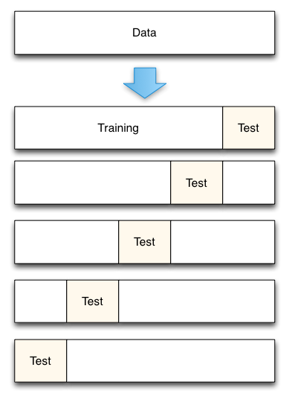
cross validation

Slide 23
cross validation
# simulate splitting a dataset of 25 observations into 5 folds
from sklearn.cross_validation import KFold
kf = KFold(25, n_folds=5, shuffle=False)
# print the contents of each training and testing set
print('{} {:^61} {}'.format('Iteration', 'Training set observations', 'Testing set observations'))
for iteration, data in enumerate(kf, start=1):
print('{:^9} {} {:^25}'.format(iteration, data[0], data[1]))

Slide 24
Dataset contains 25 observations (numbered 0 through 24)
5-fold cross-validation, thus it runs for 5 iterations
For each iteration, every observation is either in the training set or the testing set, but not both
Every observation is in the testing set exactly once

Slide 25
Comparing cross-validation to train/test split
Advantages of cross-validation:
More accurate estimate of out-of-sample accuracy
More "efficient" use of data (every observation is used for both training and testing)
Advantages of train/test split:
Runs K times faster than K-fold cross-validation
Simpler to examine the detailed results of the testing process

Slide 26
Cross-validation recommendations
K can be any number, but K=10 is generally recommended
For classification problems, stratified sampling is recommended for creating the folds
Each response class should be represented with equal proportions in each of the K folds
scikit-learn's cross_val_score function does this by default

